Slide 1



ONLINE ATTENDANCE MANAGEMENT

Slide 2
TOPICS
Introduction
Application
Technologies
User Flows
Admin Flow
User Flow
Demo

Slide 3
Introduction
Online Attendance Management is designed to make the process of registering attendance easier and simpler
Today, it’s a twostep process that involves taking the attendance first and post that entry of the same digitally
This solution targets access to the portal from anywhere just with in the college/school premises

Slide 4

Application

Slide 5
Technologies
HTML5
Bootstrap
jQuery
PHP
JavaScript
CSS3

Slide 6
User Flows
There are two different users in the application
Admin
User
Admin can create a user, assign subjects to the user.
Admin can also another admin and can give privileges.
User & Admin can take attendance, create students etc.

Slide 7
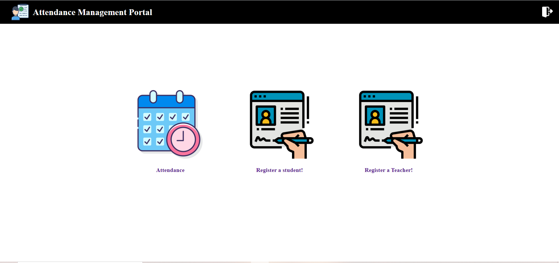
Admin Dashboard

Slide 8
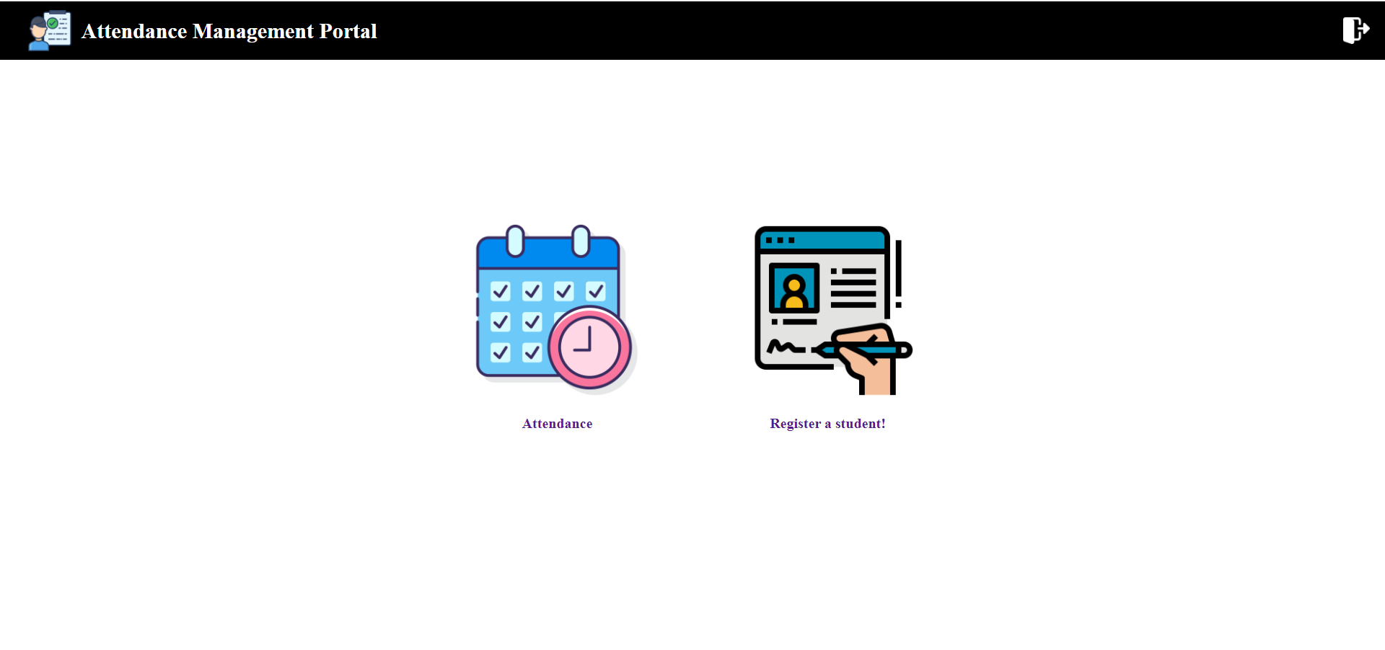
User Dashboard

Slide 9

Student Creation Page

Slide 10

User Creation Page:

Slide 11
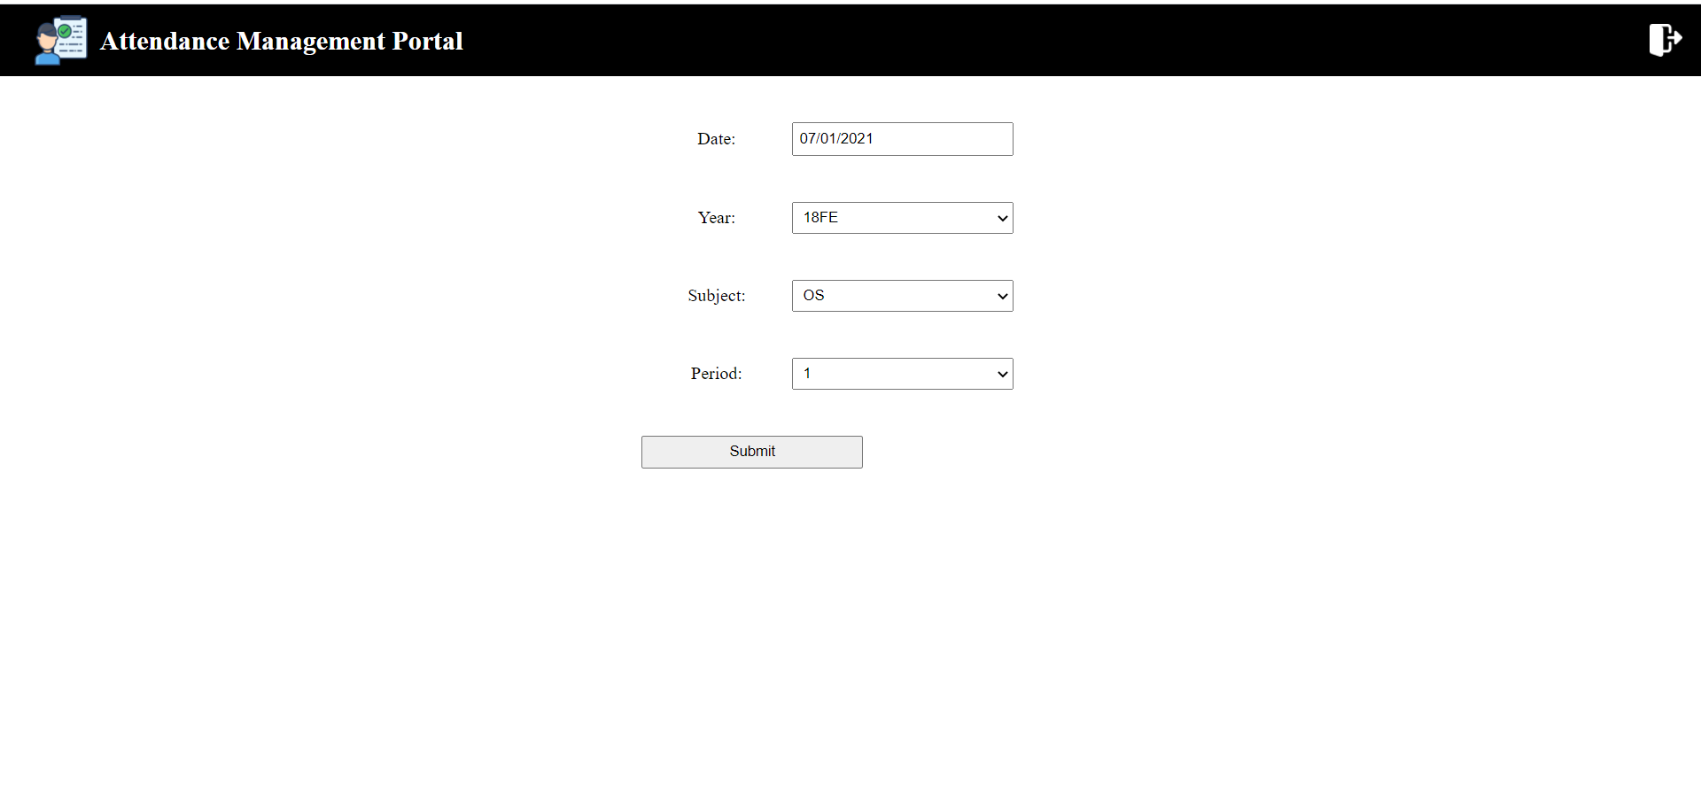
Attendance Page

Slide 12
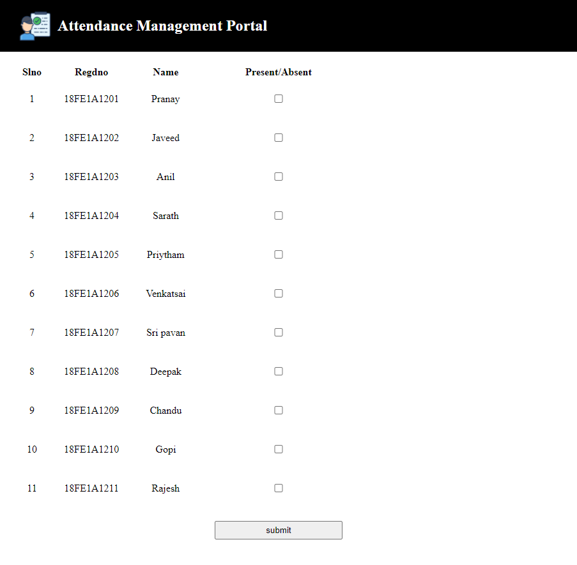
Attendance Page

Slide 13
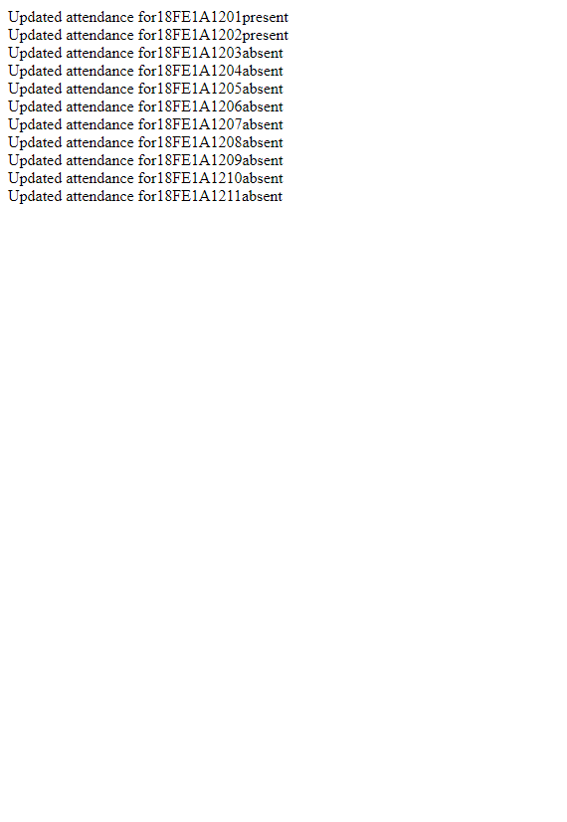
Attendance Success Page

Slide 14


Thank You!

